Slide 1
UNIT 2: Data Preprocessing
Why preprocess the data?
Descriptive data summarization
Data cleaning
Data integration and transformation
Data reduction
Discretization and concept hierarchy generation
Summary
February 19, 2008

Slide 2
Why Data Preprocessing?
Data in the real world is dirty
  incomplete: lacking attribute values, lacking certain attributes of interest, or containing only aggregate data
    e.g., occupation=“ ”
  noisy: containing errors or outliers
    e.g., Salary=“-10”
  inconsistent: containing discrepancies in codes or names
    e.g., Age=“42” Birthday=“03/07/1997”
    e.g., Was rating “1,2,3”, now rating “A, B, C”
    e.g., discrepancy between duplicate records
February 19, 2008

Slide 3

Forms of Data Preprocessing
February 19, 2008

Slide 4
Data cleaning:
Data Cleaning routines work to “clean” the data by filling in missing values, smoothing noisy data, identifying or removing outliers, and resolving inconsistencies. If users believe the data are dirty, they are unlikely to trust the results
Example:Missing occupation = "" → fill with "unknown".
Salary = -10 → detect as outlier.
Date formats like 03/07/1997 vs 1997-07-03 → standardize.
Data integration: Integrating multiple databases, data cubes, or files, is called data integration. Yet some attributes representing a given concept may have different names in different databases, causing inconsistencies and redundancies.
For example, the attribute for customer identification may be referred to as customer id in one data store and cust id in another. Naming inconsistencies may also occur for attribute values first name could be registered as“Bill” in one database, but “William” in another, and “B.” in the third

Slide 5
Data transformation:
Make data suitable for mining/analysis.operations,such as normalization and aggregation, are additional data preprocessing procedures that would contribute toward the success of the mining process.
Data reduction: obtains a reduced representation of the data set that is much smaller in volume, yet produces the same (or almost the same) analytical results. There are a number of strategies for data reduction. These include
data aggregation (e.g., building a data cube),
attribute subset selection (e.g., removing irrelevant attributes through correlationanalysis),
dimensionality reduction (e.g., using encoding schemes such as minimum length encoding or wavelets),
and numerosity reduction (e.g., “replacing” the data by alternative, smaller representations such as clusters or parametric

Slide 6
Chapter 2: Data Preprocessing
Why preprocess the data?
Descriptive data summarization
Data cleaning
Data integration and transformation
Data reduction
Discretization and concept hierarchy generation
Summary
February 19, 2008

Slide 7
Measuring the Central Tendency
Mean (algebraic measure) (sample vs. population):
  Weighted arithmetic mean:
  Trimmed mean: chopping extreme values
Median: A holistic measure
  Middle value if odd number of values, or average of the middle two values otherwise
  Estimated by interpolation (for grouped data):
Mode
  Value that occurs most frequently in the data
  Unimodal, bimodal, trimodal
  Empirical formula:
February 19, 2008

Slide 8
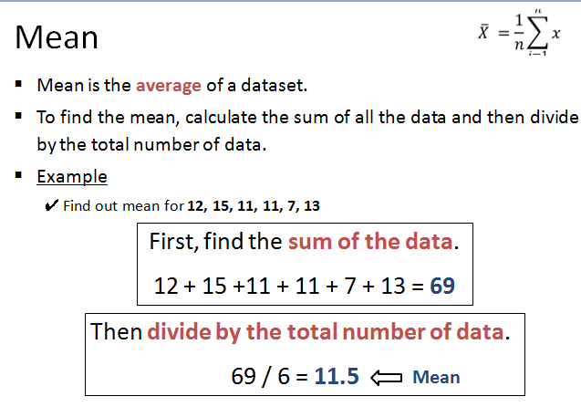

Slide 9
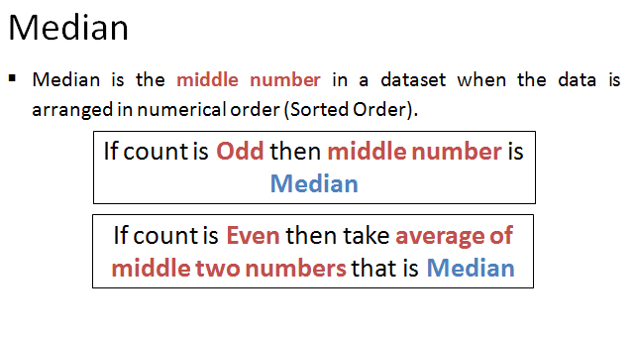

Slide 10
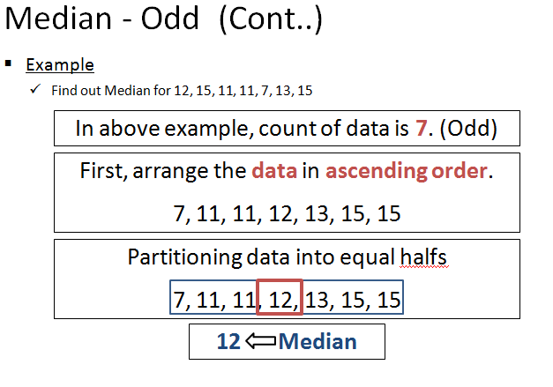

Slide 11
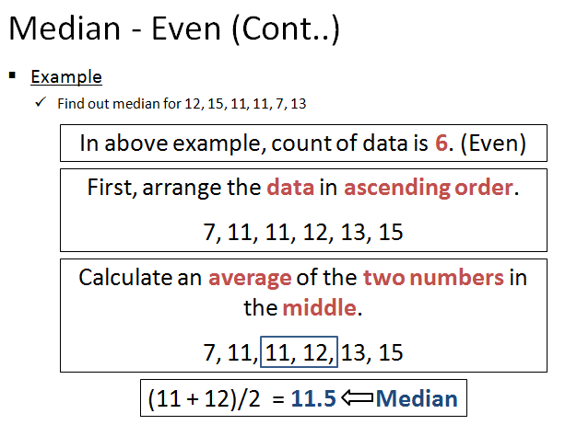

Slide 12
Measuring the Dispersion of Data
Quartiles, outliers and boxplots
  Quartiles: Q₁ (25th percentile), Q₃ (75th percentile)
  Inter-quartile range: IQR = Q₃ – Q₁
  Five number summary: min, Q₁, M, Q₃, max
  Boxplot: ends of the box are the quartiles, median is marked, whiskers, and plot outlier individually
  Outlier: usually, a value higher/lower than 1.5 x IQR
Variance and standard deviation (sample: s, population: σ)
  Variance: (algebraic, scalable computation)
  Standard deviation s (or σ) is the square root of variance s² ⁽or σ²⁾
February 19, 2008

Slide 13
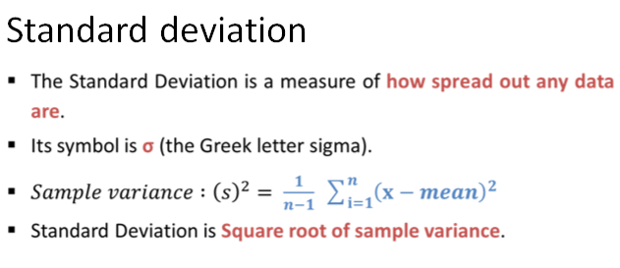

Slide 14
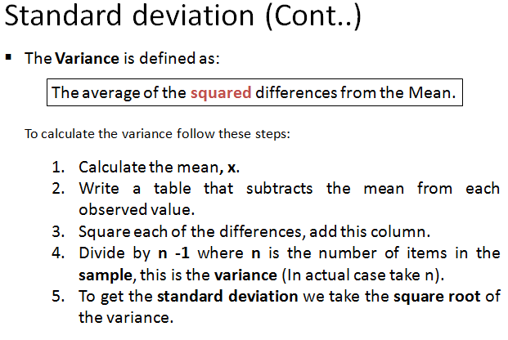

Slide 15
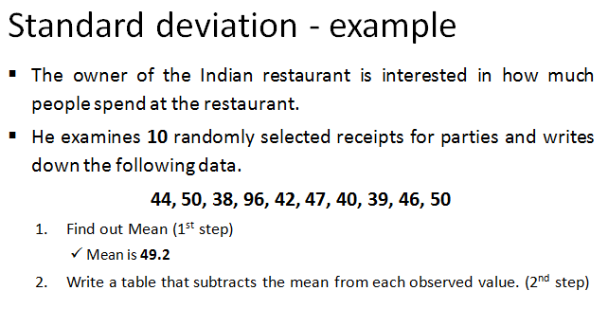

Slide 16
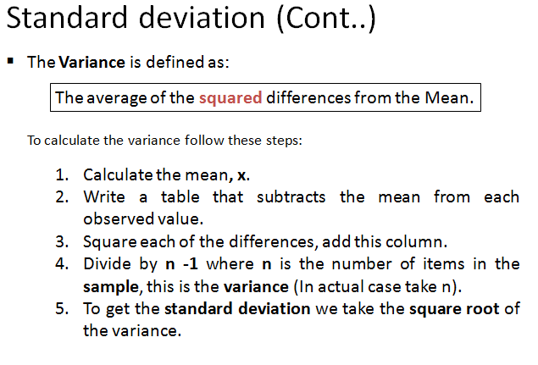

Slide 17
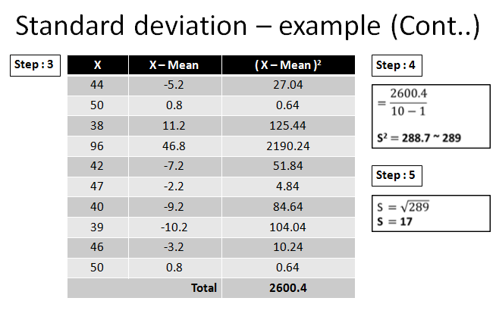

Slide 18
Chapter 2: Data Preprocessing
Why preprocess the data?
Descriptive data summarization
Data cleaning
Data integration and transformation
Data reduction
Discretization and concept hierarchy generation
Summary
February 19, 2008

Slide 19
Data Cleaning
Importance
  “Data cleaning is one of the three biggest problems in data warehousing”—Ralph Kimball
  “Data cleaning is the number one problem in data warehousing”—DCI survey
Data cleaning tasks
  Fill in missing values
  Identify outliers and smooth out noisy data
  Correct inconsistent data
  Resolve redundancy caused by data integration
February 19, 2008

Slide 20
Missing Data
Data is not always available
  E.g., many tuples have no recorded value for several attributes, such as customer income in sales data
Missing data may be due to
  equipment malfunction
  inconsistent with other recorded data and thus deleted
  data not entered due to misunderstanding
  certain data may not be considered important at the time of entry
  not register history or changes of the data
Missing data may need to be inferred.
February 19, 2008

Slide 21
How to Handle Missing Data?
1. Ignore the tuple: This is usually done when the class label is missing .This method is not very effective, unless the tuple contains several attributes with missing values. It is especially poor when the percentage of missing values per attribute varies considerably
2. Fill in the missing value manually: In general, this approach is time-consuming and may not be feasible given a large data set with many missing values.
3. Use a global constant to fill in the missing value: Replace all missing attribute values by the same constant, such as a label like “Unknown” or −∞. although this method is simple, it is not foolproof.
February 19, 2008

Slide 22
4. Use the attribute mean to fill in the missing value: For example, suppose that the average income of AllElectronics customers is $56,000. Use this value to replace the missing value for income.
5. Use the attribute mean for all samples belonging to the same class as the given tuple: For example, if classifying customers according to credit risk, replace the missing value with the average income value for customers in the same credit risk category as that of the given tuple.
6. Use the most probable value to fill in the missing value: This may be determined with regression, inference-based tools using a Bayesian formalism, or decision tree induction.

Slide 23
Noisy Data
Noise: random error or variance in a measured variable
Incorrect attribute values may due to
  faulty data collection instruments
  data entry problems
  data transmission problems
  technology limitation
  inconsistency in naming convention
Other data problems which requires data cleaning
  duplicate records
  incomplete data
  inconsistent data
February 19, 2008

Slide 24
How to Handle Noisy Data?
Binning
  first sort data and partition into (equal-frequency) bins
  then one can smooth by bin means, smooth by bin median, smooth by bin boundaries, etc.
Regression
  smooth by fitting the data into regression functions
Clustering
  detect and remove outliers
Combined computer and human inspection
  detect suspicious values and check by human (e.g., deal with possible outliers)
February 19, 2008

Slide 25
Simple Discretization Methods: Binning
Equal-width (distance) partitioning
  Divides the range into N intervals of equal size: uniform grid
  if A and B are the lowest and highest values of the attribute, the width of intervals will be: W = (B –A)/N.
  The most straightforward, but outliers may dominate presentation
  Skewed data is not handled well
Equal-depth (frequency) partitioning
  Divides the range into N intervals, each containing approximately same number of samples
  Good data scaling
  Managing categorical attributes can be tricky
February 19, 2008

Slide 26
Binning Methods for Data Smoothing
Sorted data for price (in dollars): 4, 8, 9, 15, 21, 21, 24, 25, 26, 28, 29, 34
* Partition into equal-frequency (equi-depth) bins:
- Bin 1: 4, 8, 9, 15
- Bin 2: 21, 21, 24, 25
- Bin 3: 26, 28, 29, 34
* Smoothing by bin means:
- Bin 1: 9, 9, 9, 9
- Bin 2: 23, 23, 23, 23
- Bin 3: 29, 29, 29, 29
* Smoothing by bin boundaries:
- Bin 1: 4, 4, 4, 15
- Bin 2: 21, 21, 25, 25
- Bin 3: 26, 26, 26, 34
February 19, 2008

Slide 27
Regression
Linear regression involves finding the “best” line to fit two attributes (or variables), so that one attribute can be used to predict the other.
Multiple linear regression is an extension of linear regression, where more than two attributes are involved and the data are fit to a multidimensional surface
y
Y1
Y1’
y = x + 1
X1
x
February 19, 2008

Slide 28
Cluster Analysis
February 19, 2008

Slide 29
Clustering
Clustering is a process of partitioning a set of data (or objects) into a set of meaningful sub-classes, called clusters.
It enables the abstraction of large amounts data by forming meaningful groups or categories of objects.
In clustering, objects in the same cluster are similar to each other and those in different clusters are dissimilar.
Example
  Library (Group of Books based on different categories)
  Cloths (By size S, M, L, XL, XXL etc.)

Slide 30
3) Correct inconsistent data
Data Cleaning
If you have inconsistencies in your data, it can cause major problems later on.
But with larger datasets, it can be difficult to find all of the inconsistencies.
It contains similarity in codes or names.
We can manually solve common mistakes like spelling, grammar, articles or use other tools for it.

Slide 31
4) Resolve redundancy caused by data integration
Data Cleaning
Data redundancy occurs in database systems which have a field that is repeated in two or more tables.
When customer data is duplicated and attached with each product bought, then redundancy of data is known as inconsistency.
So, the entity "customer" might appear with different values.
Database normalization prevents redundancy and makes the best possible usage of storage.
The proper use of foreign keys can minimize data redundancy and reduce the chance of destructive anomalies appearing.

Slide 32
Chapter 2: Data Preprocessing
Why preprocess the data?
Data cleaning
Data integration and transformation
Data reduction
Discretization and concept hierarchy generation
Summary
February 19, 2008

Slide 33
Data Integration
Data integration: Combines data from multiple sources into a coherent store. These sources may include multiple databases, data cubes, or flat files.
  There are a number of issues to consider during data integration.
Schema integration and object matching: e.g., A.cust-id ≡ B.cust-#
  Integrate metadata from different sources
Entity identification problem:
  Identify real world entities from multiple data sources, e.g., Bill Clinton = William Clinton
Detecting and resolving data value conflicts
  For the same real world entity, attribute values from different sources are different
  Possible reasons: different representations, different scales, e.g., metric vs. British units
February 19, 2008

Slide 34
Redundancy:Redundant data occur often when integration of multiple databases
  Object identification: The same attribute or object may have different names in different databases
  Derivable data: One attribute may be a “derived” attribute in another table, e.g., annual revenue
Redundant attributes may be able to be detected by correlation analysis.
Handling Redundancy in Data Integration
Given two attributes, such analysis can measure how strongly one attribute implies the other, based on the available data. For numerical attributes, we can evaluate the correlation between two attributes, A and B, by computing the correlation coefficient
February 19, 2008

Slide 35
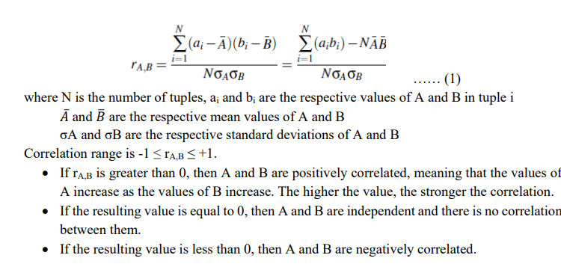
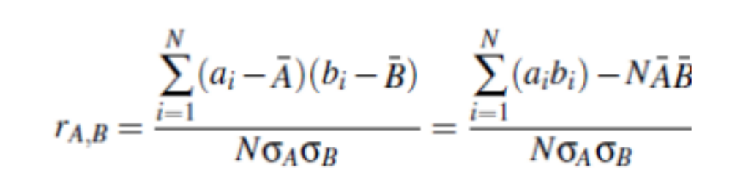


Correlation Analysis (Numerical Data)

Slide 36
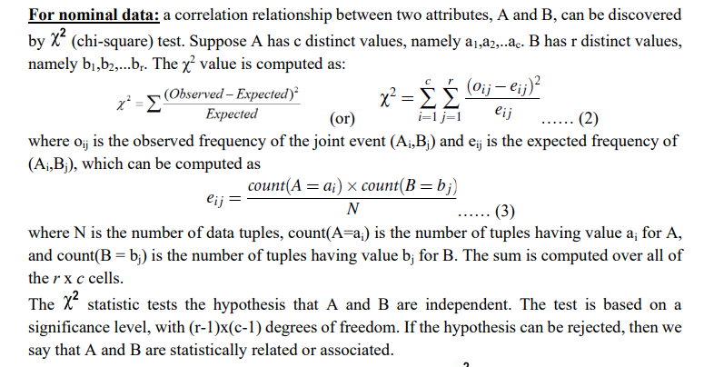

Slide 37
Chi-Square Calculation: An Example
Χ² (chi-square) calculation (numbers in parenthesis are expected counts calculated based on the data distribution in the two categories)
It shows that like_science_fiction and play_chess are correlated in the group
Play chess
Not play chess
Sum (row)
Like science fiction
250(90)
200(360)
450
Not like science fiction
50(210)
1000(840)
1050
Sum(col.)
300
1200
1500
February 19, 2008

Slide 38
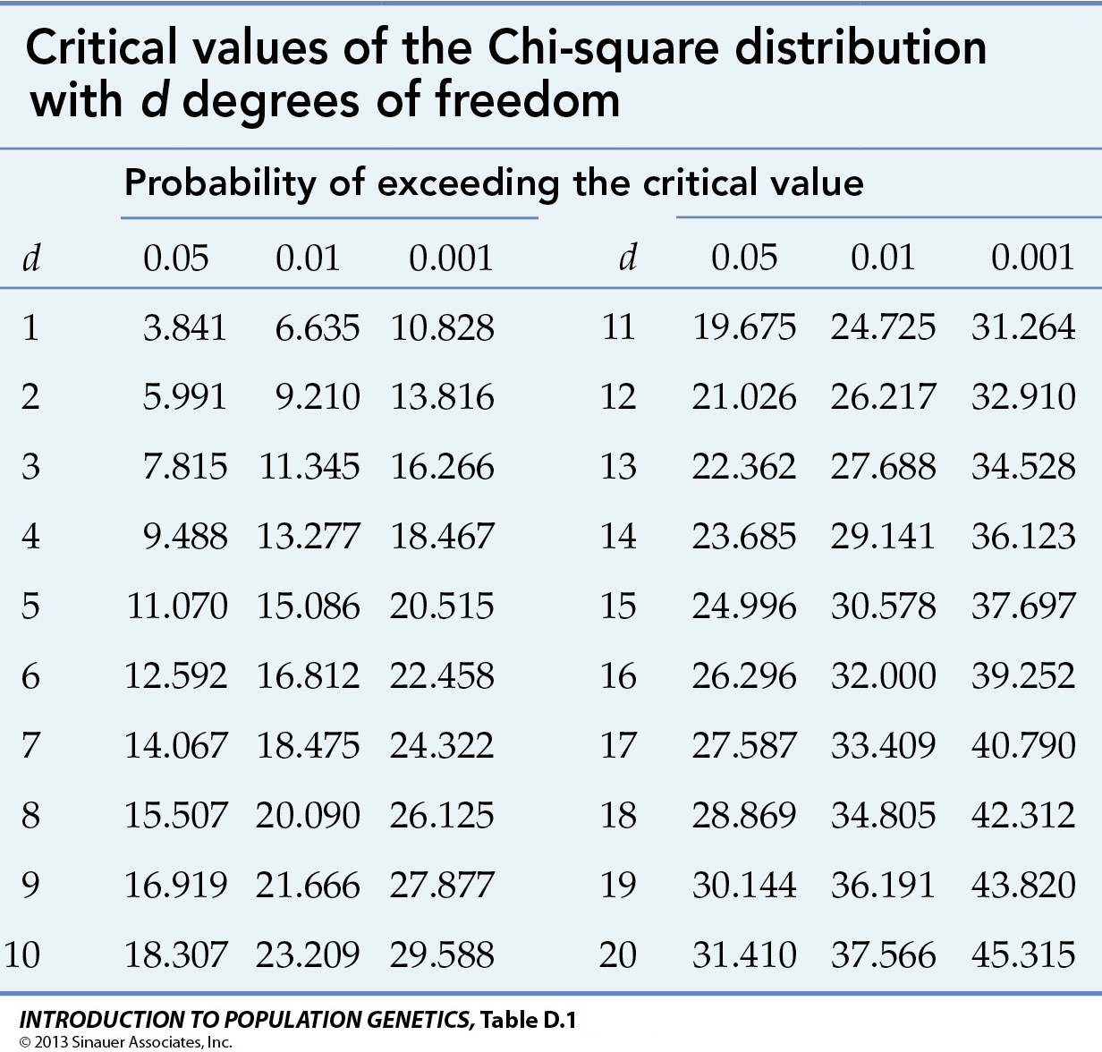

Slide 39
Data Transformation
Data transformation is the process of converting data from one form to another form.
Data often resides in different locations across the storage and also differs in format.
Data transformation is necessary to ensure that data from one application or database is understandable to other applications and databases also.

Slide 40
Data Transformation (Cont..)
Data transformation strategies includes the following:
  Smoothing
  Attribute construction
  Aggregation
  Normalization
  Discretization
  Concept hierarchy generation for nominal data

Slide 41
Data Transformation (Cont..)
Smoothing
  It works to remove noise from the data.
  It is a form of data cleaning where users specify transformations to correct data inconsistencies.
  Such techniques include binning, regression and clustering.
Attribute construction
  It is referred as new attributes are constructed and added from the given set of attributes to help the mining process.
Aggregation
  In this, summary or aggregation operations are applied to the data.
  E.g. Daily sales data are aggregated at individual source so sales manager can compute monthly and annually total amounts.

Slide 42
Data Transformation (Cont..)
Normalization
  Normalization is scaling technique or a mapping technique.
  With normalization, we can find new range from an existing range.
  There are three techniques for normalization.
  Min-Max Normalization
    This is a simple normalization technique in which we fit given data in a pre-defined boundary, or a pre-defined interval [0,1].
  z-score normalization
  This method of normalization is useful when the actual minimum and maximum of attribute A are unknown, or when there are outliers that dominate the min-max normalization.
  3.Decimal scaling
    In this technique we move the decimal point of values of the attribute.

Slide 43
1) Min-max normalization
Min max is a technique that helps to normalizing the data.
It will scale the data between 0 and 1.
Example
Age
16
20
30
40

Slide 44
1) Min-max normalization (Cont..)
Min : Minimum value = 16
Max : Maximum value = 40
V = Respective value of attributes. In our example V₁= 16, V₂=20, V₃=30 & V₄=40.
NewMax = 1
NewMin = 0

Slide 45
1) Min-max normalization (Cont..)
For Age 16 :
MinMax (v’) = (16 – 16)/(40-16) * (1 – 0) + 0
= 0 / 24 * 1
= 0
For Age 20 :
MinMax (v’) = (20 – 16)/(40-16) * (1 – 0) + 0
= 4 / 24 * 1
= 0.16

Slide 46
1) Min-max normalization (Cont..)
For Age 30 :
MinMax (v’) = (30 – 16)/(40-16) * (1 – 0) + 0
= 14 / 24 * 1
= 0.58
For Age 40 :
MinMax (v’) = (40 – 16)/(40-16) * (1 – 0) + 0
= 24 / 24 * 1
= 1
Age | After Min-max normalization
16 | 0
20 | 0.16
30 | 0.58
40 | 1

Slide 47
2) Decimal scaling
In this technique we move the decimal point of values of the attribute.
This movement of decimal points totally depends on the maximum value among all values in the attribute.
Value V of attribute A can be normalized by the following formula
Normalized value of attribute = (v^{i} / 10^{j})

Slide 48
Decimal scaling - Example
CGPA | Formula | After Decimal Scaling
2 | 2 / 10 | 0.2
3 | 3 / 10 | 0.3

Slide 49
Decimal scaling (Try it!)
Bonus | Formula | After Decimal Scaling
400 | 400/1000 | 0.4
310 | 310/1000 | 0.31
Salary | Formula | After Decimal Scaling
40,000 | 40000/100000 | 0.4
31,000 | 31000/100000 | 0.31

Slide 50

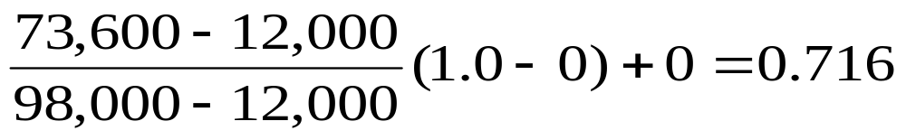
Min-max Min-max normalization: : to [new_min_{A}, new_max_{A}]
  Ex. Let income range $12,000 to $98,000 normalized to [0.0, 1.0]. Then $73,600 is mapped to

Slide 51
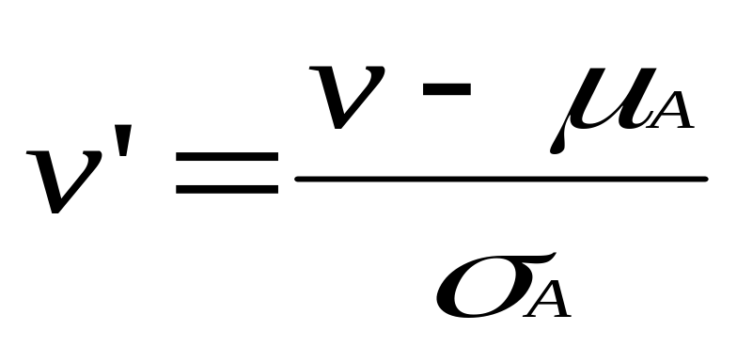
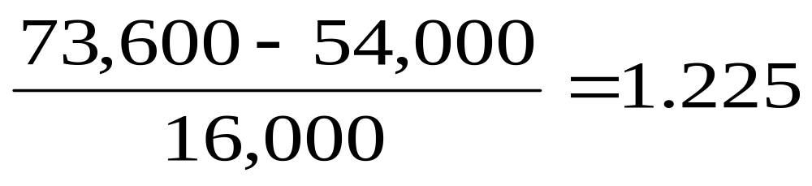
Z-score normalization (μ: mean, σ: standard deviation):
Z-score normalization (μ: mean, σ: standard deviation):
  Ex. Let μ = 54,000, σ = 16,000. Then
Z-score normalization (μ: mean, σ: standard deviation):
  Ex. Let μ = 54,000, σ = 16,000. Then

Slide 52
Chapter 2: Data Preprocessing
Why preprocess the data?
Data cleaning
Data integration and transformation
Data reduction
Discretization and concept hierarchy generation
Summary
February 19, 2008

Slide 53
Data Reduction Strategies
Why data reduction?
  A database/data warehouse may store terabytes of data
  Complex data analysis/mining may take a very long time to run on the complete data set
Data reduction
  Obtain a reduced representation of the data set that is much smaller in volume but yet produce the same (or almost the same) analytical results
February 19, 2008

Slide 54
Data reduction strategies
1. Data cube aggregation:, where aggregation operations are applied to the data in the construction of a data cube.
2. Attribute subset selection: where irrelevant, weakly relevant, or redundant attributes or dimensions may be detected and removed.
3. Dimensionality reduction:where encoding mechanisms are used to reduce the data set size.
4. Numerosity reduction:,where the data are replaced or estimated by alternative, smaller data representations such as parametric models or nonparametric methods such as clustering, sampling, and the use of histograms.

Slide 55
5. Discretization and concept hierarchy generation: where raw data values for attributes are replaced by ranges or higher conceptual levels.
Data discretization is a form of numerosity reduction that is very useful for the automatic generation of concept hierarchies.

Slide 56
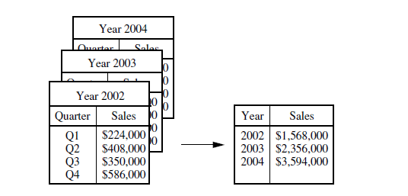
Data Cube Aggregation
Imagine that you have collected the data for your analysis. These data consist of the All Electronics sales per quarter, for the years 2002 to 2004. You are, however, interested in the annual sales (total per year), rather than the total per quarter. Thus the data can be aggregated so that the resulting data summarize the total sales per year instead of per quarter. This aggregation is illustrated in above figure. The resulting data set is smaller in volume, without loss of information necessary for the analysis task.

Slide 57
Attribute Subset Selection
Attribute subset selection reduces the data set size by removing irrelevant or redundant attributes (or dimensions).
The goal of attribute subset selection is to find a minimum set of attributes such that the resulting probability distribution of the data classes is as close as possible to the original distribution obtained using all attributes.
February 19, 2008

Slide 58
Feature selection is a must for any data mining product. because, when you build a data mining model, the dataset frequently contains more information than is needed to build the model. For example, a dataset may contain 500 columns that describe characteristics of customers, but perhaps only 50 of those columns are used to build a particular model. If you keep the unneeded columns while building the model, more CPU and memory are required during the training
process, and more storage space is required for the completed model.
• Attribute subset selection reduces the data set size by removing irrelevant or redundant attributes (or dimensions).
• The goal of attribute subset selection is to find a minimum set of attributes.
• Mining on a reduced set of attributes has an additional benefit.
• It reduces the number of attributes appearing in the discovered patterns, helping to make the patterns easier to understand.

Slide 59
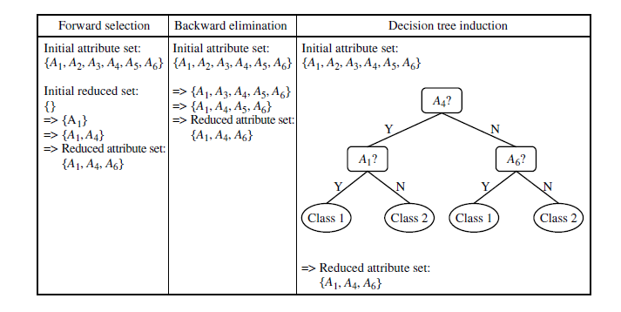

Slide 60
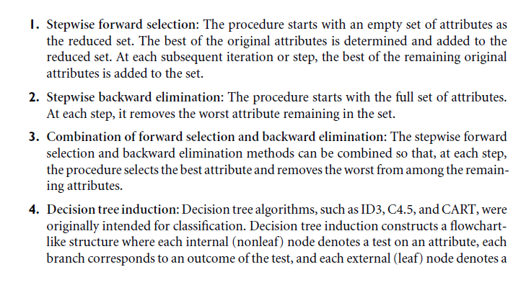

Slide 61
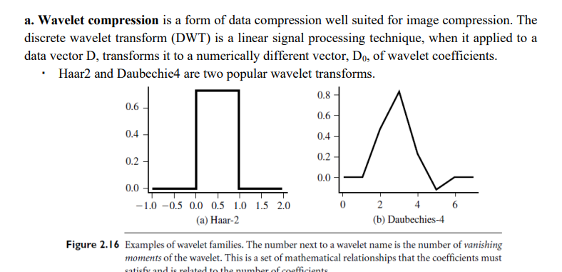
Dimensionality Reduction:
In dimensionality reduction, data encoding or transformations are applied so as to obtain a reduced or “compressed” representation of the original data. If the original data can be reconstructed from the compressed data without any loss of information, the data reduction is called lossless. The two popular and effective methods of lossy dimensionality reduction are: a. Wavelet transforms b. Principal components analysis

Slide 62
The general procedure for applying a discrete wavelet transform uses a hierarchical pyramid algorithm resulting in fast computational speed.
The method is as follows: 1. The length, L, of the input data vector must be an integer power of two. This condition can be met by padding the data vector with zeros, as necessary.
2. Each transform involves applying two functions: • data smoothing • calculating weighted difference
3. The two functions are applied to pairs of the input data, resulting in two sets of data of length L/2.
4. The two functions are recursively applied to the sets of data obtained in the previous loop, until the resulting data sets obtained are of desired length.
5. A selection of values from the data sets obtained in the above iterations are designated the wavelet coefficients of the transformed data.

Slide 63
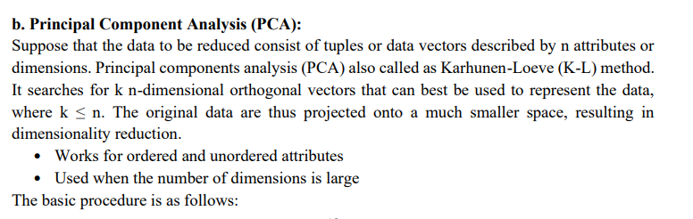

Slide 64
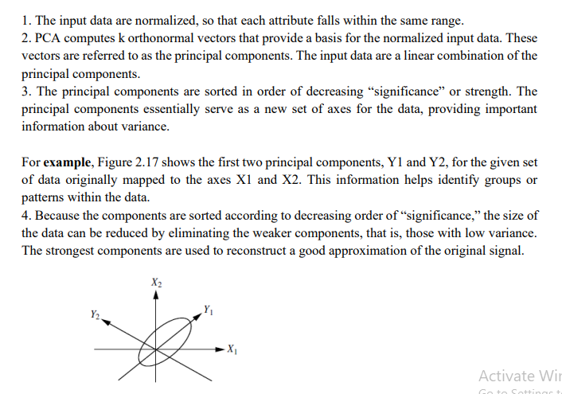

Slide 65
4. Numerosity Reduction
Data volume can be reduced by choosing alternative smaller forms of data representation. This
techniques may be
• Parametric method
• Non parametric method
Parametric: A model is used to estimate the data, only the data parameters need to be stored,instead of the actual data.
Non parametric: includes histogram, clustering and sampling methods for storing reduced representations of the data.
Numerosity reduction techniques:
1. Regression and Log-Linear Models: Can be used to approximate the given data
Linear regression, the data are modelled to fit a straight line using

Slide 66
Y = α + β X, where α, β are coefficients
Multiple linear regression: it is an extension of linear regression, which allows a response variable, y, to be modelled as a linear function of two or more predictor variables.
Y = b0 + b1 X1 + b2 X2.
Log-linear model: approximate discrete multidimensional probability distributions. These models are also useful for dimensionality reduction and data smoothing.
Probability: p(a, b, c, d) = α ab β ac γ ad δ bcd
2. Histograms Histogram for an attribute ‘A’ partitions the data distribution of A into disjoint subsets or buckets. If each bucket represents only a single attribute-value/frequency pair, the buckets are called singleton buckets. Often, buckets represent continuous ranges for the given attribute. Example: Histograms. The following data are a list of prices of commonly sold items at All Electronics (rounded to the nearest dollar). The numbers have been sorted: 1, 1, 5, 5, 5, 5, 5, 8, 8, 10, 10, 10, 10, 12, 14, 14, 14, 15, 15, 15, 15, 15, 15, 18, 18, 18, 18, 18, 18, 18, 18, 20, 20, 20, 20, 20, 20, 20, 21, 21, 21, 21, 25, 25, 25, 25, 25, 28, 28, 30, 30, 30. Draw histogram plot for price where each bucket should have equi-width of 10

Slide 67
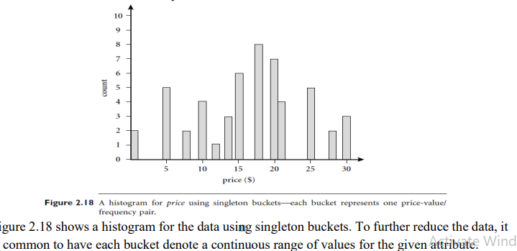
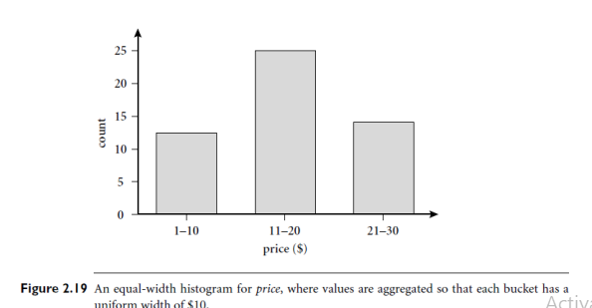

Slide 68
In Figure 2.19, each bucket represents a different $10 range for price. The buckets can be determined based on the following partitioning rules:
1. Equi-width: the width of each bucket range is uniform.
2. Equi-depth: the frequency of each bucket is constant
3. V-Optimal: histogram with least variance
4. MaxDiff: considers the difference between each pair of adjacent values. A bucket boundary is established between each pair for pairs having the β -1 largest differences, where β is the user-specified number of buckets.
Clustering: Clustering techniques consider data tuples as objects. They partition the objects into groups or clusters, so that objects within a cluster are “similar" to one another and “dissimilar" to objects in other clusters. Centroid distance is an alternative measure of cluster quality and is defined as the average distance of each cluster object from the cluster centroid. The cluster representations of the data are used to replace the actual data.

Slide 69
Sampling: Sampling can be used as a data reduction technique as it allows a large data set to be represented by a much smaller random sample (or subset) of the data. Suppose that a large data set D contains N tuples. Let's have a look at the ways for data reduction illustrated in fig.

Slide 70
Sampling: with or without Replacement
SRSWOR
(simple random
sample without
replacement)
SRSWR
Raw Data
February 19, 2008

Slide 71
Sampling: Cluster or Stratified Sampling
Raw Data
Cluster/Stratified Sample
February 19, 2008

Slide 72
Chapter 2: Data Preprocessing
Why preprocess the data?
Data cleaning
Data integration and transformation
Data reduction
Discretization and concept hierarchy generation
Summary
February 19, 2008

Slide 73
Discretization
Three types of attributes:
  Nominal — values from an unordered set, e.g., color, profession
  Ordinal — values from an ordered set, e.g., military or academic rank
  Continuous — real numbers, e.g., integer or real numbers
Discretization:
  Divide the range of a continuous attribute into intervals
  Some classification algorithms only accept categorical attributes.
  Reduce data size by discretization
  Prepare for further analysis
February 19, 2008

Slide 74
Discretization and Concept Hierarchy
Discretization
  Reduce the number of values for a given continuous attribute by dividing the range of the attribute into intervals
  Interval labels can then be used to replace actual data values
  Supervised vs. unsupervised
  Split (top-down) vs. merge (bottom-up)
  Discretization can be performed recursively on an attribute
Concept hierarchy formation
  Recursively reduce the data by collecting and replacing low level concepts (such as numeric values for age) by higher level concepts (such as young, middle-aged, or senior)
February 19, 2008

Slide 75
Discretization and Concept Hierarchy Generation for Numeric Data
Typical methods: All the methods can be applied recursively
  Binning (covered above)
    Top-down split, unsupervised,
  Histogram analysis (covered above)
    Top-down split, unsupervised
  Clustering analysis (covered above)
    Either top-down split or bottom-up merge, unsupervised
  Entropy-based discretization: supervised, top-down split
  Interval merging by χ² Analysis: unsupervised, bottom-up merge
  Segmentation by natural partitioning: top-down split, unsupervised
February 19, 2008

Slide 76
Segmentation by Natural Partitioning
A simply 3-4-5 rule can be used to segment numeric data into relatively uniform, “natural” intervals.
  If an interval covers 3, 6, 7 or 9 distinct values at the most significant digit, partition the range into 3 equi-width intervals
  If it covers 2, 4, or 8 distinct values at the most significant digit, partition the range into 4 intervals
  If it covers 1, 5, or 10 distinct values at the most significant digit, partition the range into 5 intervals
February 19, 2008

Slide 77
Example of 3-4-5 Rule
count
Step 1:
-$351 -$159 profit $1,838 $4,700
Min Low (i.e, 5%-tile) High(i.e, 95%-0 tile) Max
Step 2:
msd=1,000 Low=-$1,000 High=$2,000
Step 3:
(-$1,000 - $2,000)
(-$1,000 - 0)
(0 -$ 1,000)
($1,000 - $2,000)
Step 4:
(-$400 -$5,000)
(-$400 - 0)
(0 - $1,000)
($1,000 - $2, 000)
($2,000 - $5, 000)
(-$400 -
-$300)
(0 -
$200)
($1,000 -
$1,200)
($2,000 -
$3,000)
($200 -
$400)
($1,200 -
$1,400)
(-$300 -
-$200)
($3,000 -
$4,000)
($400 -
$600)
($1,400 -
$1,600)
(-$200 -
-$100)
($4,000 -
$5,000)
($600 -
$800)
($1,600 -
$1,800)
($1,800 -
$2,000)
(-$100 -
0)
($800 -
$1,000)
February 19, 2008

Slide 78
Concept Hierarchy Generation for Categorical Data
Specification of a partial/total ordering of attributes explicitly at the schema level by users or experts
  street < city < state < country
Specification of a hierarchy for a set of values by explicit data grouping
  {Urbana, Champaign, Chicago} < Illinois
Specification of only a partial set of attributes
  E.g., only street < city, not others
Automatic generation of hierarchies (or attribute levels) by the analysis of the number of distinct values
  E.g., for a set of attributes: {street, city, state, country}
February 19, 2008

Slide 79
Automatic Concept Hierarchy Generation
Some hierarchies can be automatically generated based on the analysis of the number of distinct values per attribute in the data set
  The attribute with the most distinct values is placed at the lowest level of the hierarchy
  Exceptions, e.g., weekday, month, quarter, year
15 distinct values
country
province_or_ state
365 distinct values
city
3567 distinct values
674,339 distinct values
street
February 19, 2008

Slide 80
Chapter 2: Data Preprocessing
Why preprocess the data?
Data cleaning
Data integration and transformation
Data reduction
Discretization and concept hierarchy generation
Summary
February 19, 2008

Slide 81
Summary
Data preparation or preprocessing is a big issue for both data warehousing and data mining
Discriptive data summarization is need for quality data preprocessing
Data preparation includes
  Data cleaning and data integration
  Data reduction and feature selection
  Discretization
A lot a methods have been developed but data preprocessing still an active area of research
February 19, 2008

Slide 82
References
D. P. Ballou and G. K. Tayi. Enhancing data quality in data warehouse environments. Communications of ACM, 42:73-78, 1999
T. Dasu and T. Johnson. Exploratory Data Mining and Data Cleaning. John Wiley & Sons, 2003
T. Dasu, T. Johnson, S. Muthukrishnan, V. Shkapenyuk. Mining Database Structure; Or, How to Build a Data Quality Browser. SIGMOD’02.
H.V. Jagadish et al., Special Issue on Data Reduction Techniques. Bulletin of the Technical Committee on Data Engineering, 20(4), December 1997
D. Pyle. Data Preparation for Data Mining. Morgan Kaufmann, 1999
E. Rahm and H. H. Do. Data Cleaning: Problems and Current Approaches. IEEE Bulletin of the Technical Committee on Data Engineering. Vol.23, No.4
V. Raman and J. Hellerstein. Potters Wheel: An Interactive Framework for Data Cleaning and Transformation, VLDB’2001
T. Redman. Data Quality: Management and Technology. Bantam Books, 1992
Y. Wand and R. Wang. Anchoring data quality dimensions ontological foundations. Communications of ACM, 39:86-95, 1996
R. Wang, V. Storey, and C. Firth. A framework for analysis of data quality research. IEEE Trans. Knowledge and Data Engineering, 7:623-640, 1995
February 19, 2008

